Slide 1
SKILL 2.2: DESCRIBE SOME OF THE CORE PRODUCTS AVAILABLE IN AZURE

Slide 2
Executive summary
The core Azure products in 4 different categories
Azure compute
Azure networking
Azure storage
Azure database
This refers to the resources that provide computing power to run your applications. Azure offers both IaaS and PaaS compute products.
These products provide connectivity between Azure resources, and to and from the Internet or your on-premises resources.
These products give you secure and reliable cloud storage for your data..
These products provide highly-scalable solutions for hosting databases of many varieties.
Source: …

Slide 3
Agenda
Azure compute
Azure networking
Azure storage products
Azure database products
The Azure Marketplace and its usage scenarios

Slide 4
Azure Compute products
Allow you to easily and dynamically allocate resources that are needed for any computing task.
You can create compute resources quickly when you need them, and when your needs grow
You can scale those resources to handle additional requirements.
By using Azure compute resources for your computing needs, you can more easily control costs because you don’t pay for resources unless you need them.
Can also allocate infrastructure much more quickly than you can in the on-premises world
Some examples of compute products in Azure are Azure Virtual Machines, Azure App Service, container offerings in Azure, and serverless computing

Slide 5
Azure Compute products
A virtual machine (VM) is a software-based computer that runs on a physical computer. The physical computer is considered the host, and it provides the underlying physical components such as disk space, memory, CPU power, and so on. The host computer runs software called a hypervisor that can create and manage one or more VMs, and those VMs are commonly referred to as guests.
The operating system on a guest doesn’t have to be the same operating system that the host is running. If your host is running Windows 10, you can run a guest that uses Windows Server 2016, Linux, or many other operating systems. This flexibility makes VMs extremely popular. However, because the VMs running on a host use the physical systems on that host, if you have a need for a powerful VM, you’ll need a powerful physical computer to host it.
By using Azure Virtual Machines, you can take advantage of powerful host computers that Microsoft makes available when you need computing power, and when you no longer need that power, you no longer have to pay for it.
Azure Virtual Machines

Slide 6
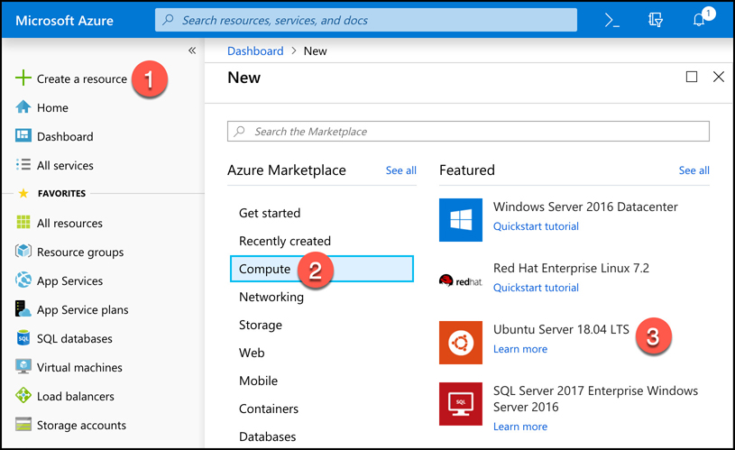
Azure Compute products
To create an Azure Virtual Machine, log into the Azure portal using your Azure account and then follow these steps:
Click Create A Resource.
Click Compute.
Click Ubuntu Server.
Azure Virtual Machines

Slide 7
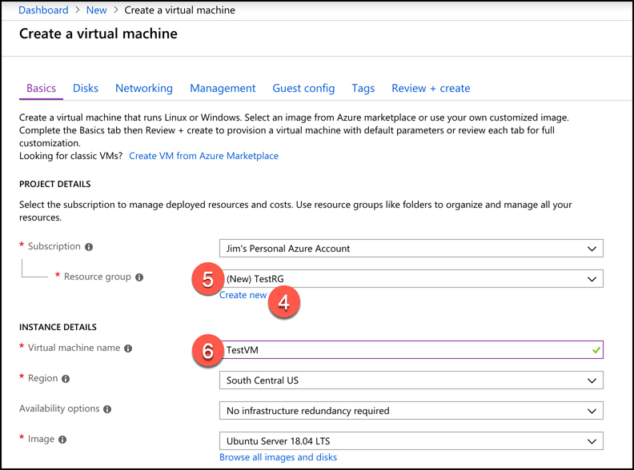
Azure Compute products
Next to Resource Group, click Create New to create a new resource group.
Enter TestRG as the resource group name and click OK.
Enter TestVM as your VM name.
Azure Virtual Machines

Slide 8
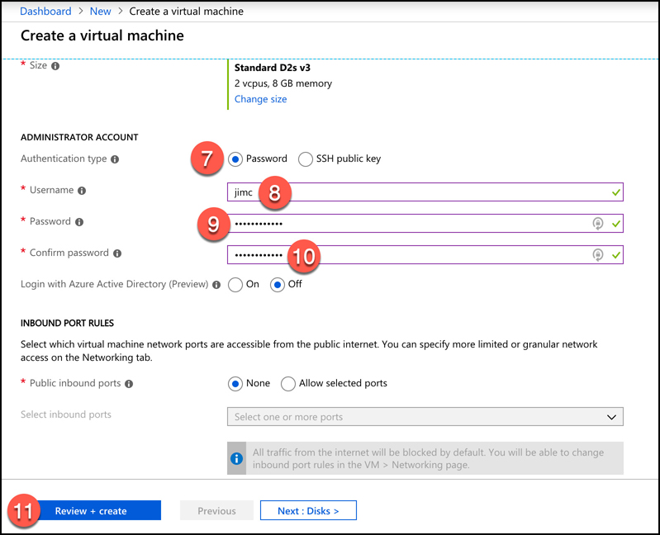
Azure Compute products
Scroll down and select Password for the authentication type.
Enter a username for your administrator account.
Enter a password you’d like to use for your administrator account.
Confirm the password.
Leave all the other settings as they are and click Review + Create to validate your settings.
Azure Virtual Machines

Slide 9
Azure Compute products
After you click Review + Create, Azure will validate your settings to make sure you haven’t left anything out. Once your validation has passed, you will see a Create button. Click the Create button to start the deployment of your new VM.
When you click Create to create your VM, the Azure portal is actually using an ARM template to deploy your VM. That ARM template contains parameters that are replaced with the information you entered for your VM. Every VM that is created in Azure is created using an ARM template. This ensures that the deployments are consistent.
Azure Virtual Machines

Slide 10
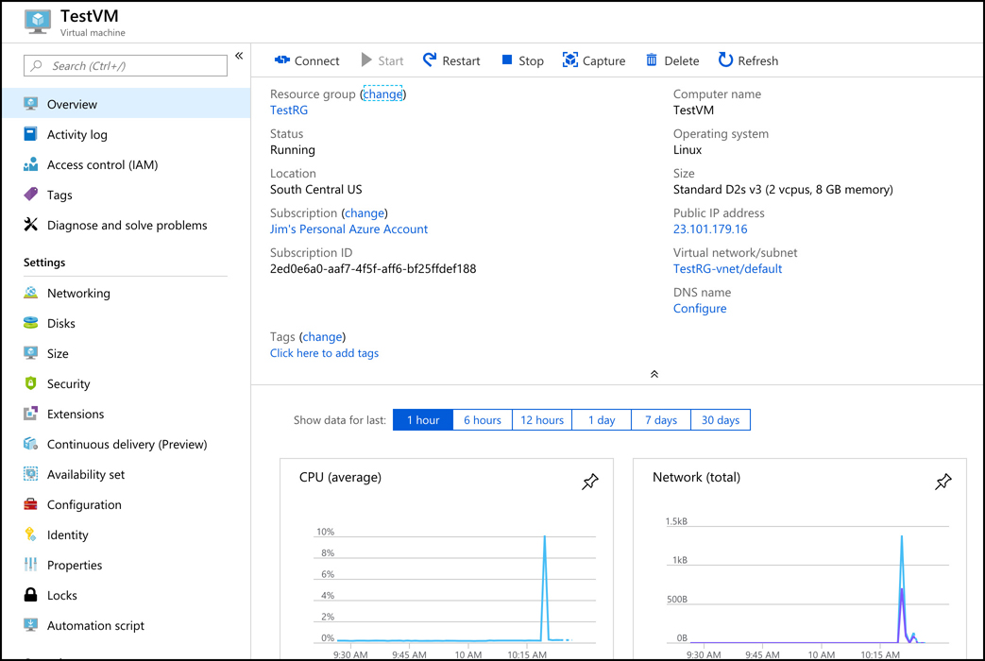
Azure Compute products
Once all the resources required for your VM are created, your VM will be considered fully deployed. You’ll then be able to click the Go To Resource button to see the management interface for your VM in the Azure portal.
Azure Virtual Machines

Slide 11
Azure Compute products
Our new VM is a guest on a physical computer with an Azure datacenter. In that datacenter is a physical rack of computer servers, and our VM is hosted on one of those servers. The host computer is managed by Microsoft, but the VM is managed by you, because this is an IaaS offering in Azure.
You are charged for Azure VMs as long as they are running. To stop billing for this VM, click the Stop button at the top of the screen. Azure will save the current state of the VM and billing will stop. You won’t be able to use the VM while it’s in a stopped state, but you will also avoid the billing of that VM. Keep in mind that unless you have configured a static IP address for your VM, your IP address will likely change the next time you start it.
You can also stop a VM from within the guest operating system on the VM, but when you do that, you will still be charged for the resources the VM uses because it’s still allocated to you. That means you’ll still incur charges for managed disks and other resources.
Azure Virtual Machines

Slide 12
Azure Compute products
VM is susceptible to downtime due to three types of events: planned maintenance, unplanned maintenance, and unexpected downtime.
Planned maintenance refers to planned updates that Microsoft makes to the host computer. This includes things like operating system updates, driver updates, and so on. In many cases, updates won’t impact your VM, but if Microsoft installs an update that requires a reboot of the host computer, your VM will be down during that reboot.
Azure has underlying systems that constantly monitor the health of computer components. If one of these underlying systems detects that a component within the host computer might fail soon, Azure will flag the computer for unplanned maintenance.
In an unplanned maintenance event, Azure will attempt to move your VM to a healthy host computer. When it does this, it preserves the state of the VM, including what’s in memory and any files that are open. It only takes Azure a short time to move the VM, during which time it’s in a paused state. In a case where the move operation fails, the VM will experience unexpected downtime.
Azure Virtual Machines

Slide 13
Azure Compute products
In order to ensure reliability when a failure occurs in a rack within the Azure datacenter, you can (and you should) take advantage of a feature called availability sets.
Availability sets protect you from maintenance events and downtime caused by hardware failures. To do that, Azure creates some underlying entities in an availability set called update domains and fault domains. (In order to protect yourself in the event of maintenance events or downtime, you must deploy at least two VMs into your availability set transpose).
Fault domains are a logical representation of the physical rack in which a host computer is installed. By default, Azure assigns two fault domains to an availability set. If a problem occurs in one fault domain (one computer rack), the VMs in that fault domain will be impacted, but VMs in the second fault domain will not be. This protects you from unplanned maintenance events and unexpected downtime.
Update domains are designed to protect you from a situation where the host computer is being rebooted. When you create an availability set, Azure creates five update domains by default. These update domains are spread across the fault domains in the availability set. If a reboot is required on computers in the availability set (whether host computers or VMs within the availability set), Azure will only reboot computers in one update domain at a time and it will wait 30 minutes for computers to recover from the reboot before it moves on to the next update domain. Update domains protect you from planned maintenance events.
Azure Virtual Machines

Slide 14
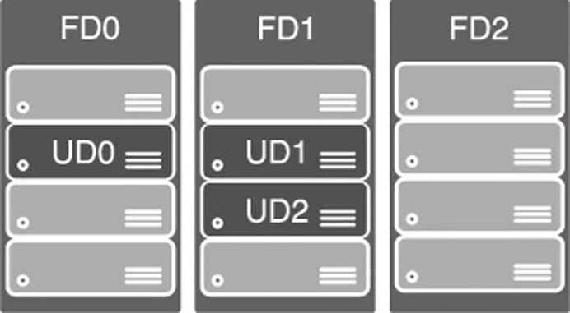
Azure Compute products
In this diagram, the fault domains FD0, FD1, and FD2 encompass three physical racks of computers. UD0, UD1, and UD2 are update domains within the fault domains.
Azure Virtual Machines
Azure Virtual Machines
- Availability Set

Slide 15
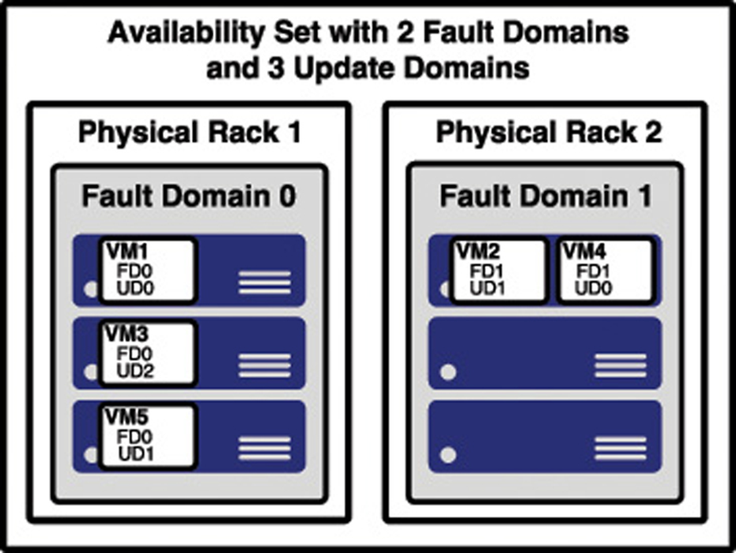
Azure Compute products
Azure Virtual Machines
- Availability Set
The figure shows a better representation of an availability set, with five VMs in the availability set. There are two fault domains and three update domains. When VMs were created in this availability set, they were assigned as follows:
The first VM is assigned Fault Domain 0 and Update Domain 0.
The second VM is assigned Fault Domain 1 and Update Domain 1.
The third VM is assigned Fault Domain 0 and Update Domain 2.
The fourth VM is assigned Fault Domain 1 and Update Domain 0.
The fifth VM is assigned Fault Domain 0 and Update Domain 1.

Slide 16
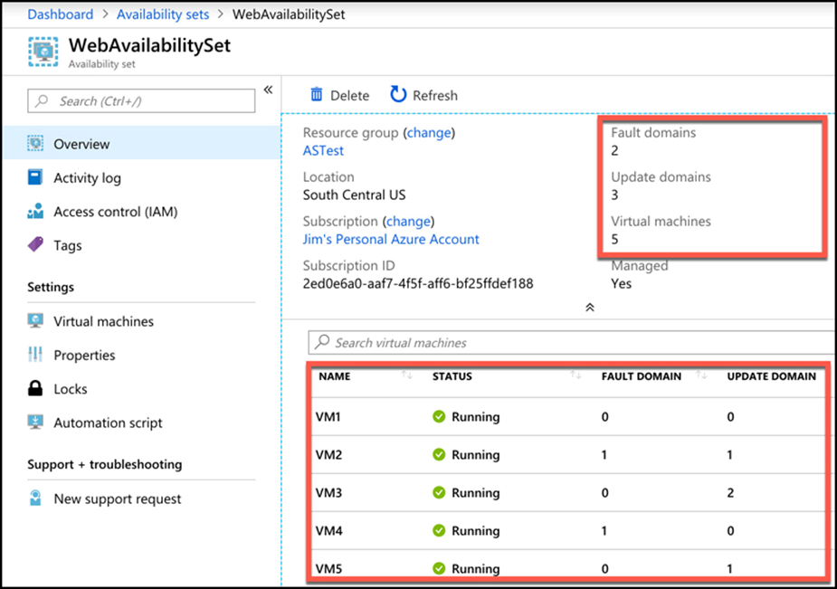
Azure Compute products
You can verify the placement of fault domains and update domains by creating five VMs in an availability set with two fault domains and three update domains.
Azure virtual machines
Azure virtual machines
- Availability Set

Slide 17
Azure Compute products
Some disadvantages of Availability sets:
Every machine in an availability set has to be explicitly created. While you can use an ARM template to deploy multiple virtual machines in one deployment, you still have to configure those machines with the software and configuration necessary to support your application.
An availability set also requires that you configure something in front of your VMs that will handle the distribution of traffic to those VMs. For example, if your availability set is servicing a website hosted on the VMs, you’ll need to configure a load balancer that will handle the job of routing users of your website to the VMs that are running it.
Higher cost. You might pay for many more VMs than you need.
Azure virtual machines
Azure virtual machines
- Availability Set

Slide 18
Azure Compute products
Azure offers another feature for VMs called scale sets that solves the problems of Availability sets nicely.
When you create a scale set, you tell Azure what operating system you want to run and then you tell Azure how many VMs you want in your scale set. You have many other options such as creating a load balancer or gateway and so forth. Azure will create as many VMs as you specified (up to 1,000) in one easy step.
Scale sets are deployed in availability sets automatically, so you automatically benefit from multiple fault domains and update domains. Unlike VMs in an availability set, however, VMs in a scale set are also compatible with availability zones, so you are protected from problems in an Azure datacenter.
You can also scale a scale set in a situation where you need more or fewer VMs. You might start with only one VM in a scale set, but as load on that VM increases, you might want to automatically add additional VMs. Scale sets provide that functionality by using Azure’s auto-scale feature. You define scaling rules that use metrics like CPU, disk usage, network usage, and so forth. You can configure when Azure should add additional instances and when it should scale back and deallocate instances. This is a great way to ensure availability while reducing costs by taking advantage of the elasticity that auto-scale provides.
Azure virtual machines
Azure virtual machines
- Scale Sets
Notes:
https://docs.microsoft.com/azure/virtual-machine-scale-sets/virtual-machine-scale-sets-deploy-app#build-a-custom-vm-image.

Slide 19
Azure Compute products
One of the most complex aspects of moving to the cloud is dealing with the complexities of moving to a new environment. To help with this problem and to make it easier to shift applications into new environments, the concept of containers was invented.
In order to run an application in a container, a computer needs to have a container runtime installed on it. The most popular container runtime is Docker, a runtime developed and maintained by a company called Docker Inc. Docker not only knows how to run applications in containers, but it also enforces certain conditions to ensure a secure environment.
Each container operates within an isolated environment. It has its own network, its own storage, and so on.
Containers
Notes:
You aren’t limited to your own images. In fact, Docker runs a repository of images that you are free to use in your own applications. You can find it at: https://hub.docker.com.

Slide 20
Azure Compute products
Azure offers numerous technologies for hosting containers.
Azure Container Instances (ACI) is a PaaS service that makes it easy to start a container with minimal configuration. You simply tell ACI where to find the image (using either a Docker tag or a URL to the image) and some basic configuration for the VM you want the container to run on.
Azure creates server resources as needed to run your container, but you’re not paying for an underlying VM. Instead, you pay for the memory and CPU that your container uses.
ACI is designed to work with simple applications. You can define a container group and run multiple containers within an ACI instance, but if you have an application that is used heavily by many people and that might need to take advantage of scaling, ACI isn’t a good choice for you. Instead, Azure’s Kubernetes Service (AKS) would be a better choice
Containers
Notes:
You aren’t limited to your own images. In fact, Docker runs a repository of images that you are free to use in your own applications. You can find it at: https://hub.docker.com.

Slide 21
Azure Compute products
Kubernetes is a container orchestration service. This means that it’s responsible for monitoring containers and ensuring that they’re always running. It can also scale to add additional containers when the needs require it to, and it can then scale back when the needs are reduced.
Kubernetes creates containers in a pod. A pod is a group of related containers, and containers within a pod are able to share resources. This is one of the advantages to using Kubernetes, because it releases you from the resource-sharing restriction typically imposed in a multi-container environment. However, a container in one pod is not able to share resources with a container in another pod.
The computer that Kubernetes pods are running on is called a node or a worker. This computer must have a container runtime such as Docker running on it. In addition to pods, the node also runs several services that are required for Kubernetes to manage the pods, and so on.
There will typically be multiple nodes within a Kubernetes instance, and they are all controlled by a master node called the Kubernetes master. The entire environment of the master and all of its nodes is called a Kubernetes cluster
Containers
Notes:
You aren’t limited to your own images. In fact, Docker runs a repository of images that you are free to use in your own applications. You can find it at: https://hub.docker.com.

Slide 22
Azure Compute products
A Kubernetes master contains all of the configuration and services necessary to manage the orchestration of pods and other Kubernetes entities. Configuring a master can be complex, and it is by far the most laborious task of using Kubernetes. For that reason, services such as Azure Kubernetes Service (AKS) are becoming more popular.
AKS offloads the burden of dealing with the Kubernetes master to Microsoft. When you create a Kubernetes cluster in AKS, Azure creates the master and the nodes for you. All you have to do is deploy your containers, and you’re up and running with a managed Kubernetes cluster.
While AKS makes adopting and managing Kubernetes easier, it doesn’t completely obfuscate Kubernetes. In order to deploy your applications, you still need to understand how to use Kubernetes, and in some cases you’ll need to use the Kubernetes command line. Azure, however, makes it far easier than doing all of the legwork and maintenance yourself. Even better, AKS in Azure is free. You only pay for the Azure computer for resources that you use within your cluster.
Containers
Notes:
You aren’t limited to your own images. In fact, Docker runs a repository of images that you are free to use in your own applications. You can find it at: https://hub.docker.com.

Slide 23
Azure Compute products
For a true PaaS experience in container hosting, Microsoft offers Web App for Containers, a feature of Azure App Service. When you create a Web App for Containers app, you specify the OS you want (either Windows or Linux) and you specify the location of the Docker image.
Microsoft manages the infrastructure that’s involved, so you only have to worry about the application contained in the image.
Unlike ACI, you pay for Azure App Service whether you’re using the application or not, because your application is running on a dedicated VM in App Service. That VM is associated with an App Service plan, and each App Service plan is associated with a specific pricing tier. You can change the pricing tier of your App Service Plan at any time.
Another benefit of using Web App for Containers is that, because it’s a true PaaS service, it offers many turnkey features that you can use in your application without having to deal with complicated development or configuration issues.
Containers
Notes:
You aren’t limited to your own images. In fact, Docker runs a repository of images that you are free to use in your own applications. You can find it at: https://hub.docker.com.

Slide 24
Agenda
Azure compute
Azure networking
Azure storage products
Azure database products
The Azure Marketplace and its usage scenarios

Slide 25
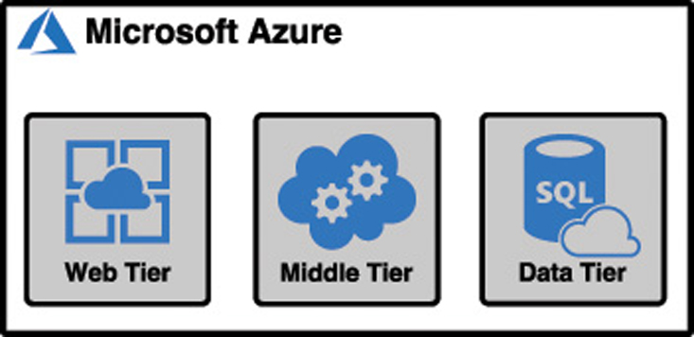
Azure Networking products
Applications should be designed using a loosely-coupled architecture.
In a loosely-coupled architecture, each component of an application can be replaced or updated without breaking the application. In order to design applications in this way, you have to separate out the various components, and they need to operate in their own tier of the application. Applications designed in this way are referred to as N-tier applications.

Slide 26
Azure Networking products
An Azure virtual network (often called a VNET) allows Azure services to communicate with each other and with the Internet. You can even use a VNET to communicate between your on-premises resources and your Azure resources.
When you created the virtual machine, Azure created a VNET for you. Without that VNET, you wouldn’t be able to remote into the VM, or use the VM for any of your applications.
You can also create your own VNET and configure it any way you choose.
An Azure VNET is just like any other computer network. It’s comprised of a network interface card (a NIC), IP addresses, and so on. You can break up your VNET into multiple subnets and set up a portion of your network’s IP address space for those subnets. You can then configure rules that control the connectivity between those subnets.
In most cases, you create VNETs before you create the resources that use them.
A public IP address doesn’t have to be assigned to a resource in order for that resource to connect outbound to the Internet. Azure maintains a pool of public IP addresses that can be dynamically assigned to a resource if it needs to connect outbound.
Azure Virtual network

Slide 27
Azure Networking products
App Service takes care of ensuring that load is distributed across all of the VMs we’re using. App Service uses a load balancer to do this, and one of the advantages of choosing a PaaS offering for the web tier is that you don’t have to worry about Managing it.
This kind of configuration is typical in order to maintain high-availability in your application, but it does add an additional layer of complexity.
Since each of these VMs has its own public IP address, a user is going to use only one VM. Ideally you have a system in place that ensures if one of these VMs experiences a problem, any traffic is sent to the other VMs.
In addition to that, when there’s high load, you want to spread the load across all three of these VMs. The solution to this problem is to use Azure LoadBalancer.
Azure Load Balancer

Slide 28
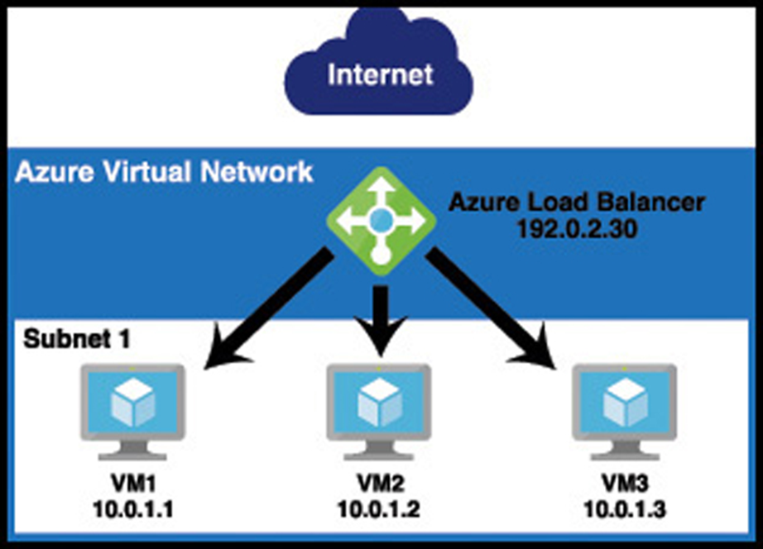
Azure Networking products
Azure Load Balancer is inside of the VNET, but it sits between the user and the subnet. When a user connects to the web tier, she connects to the load balancer’s IP address, not the IP address of one of my VMs. The load balancer routes requests into the web tier to the VMs, and it can use rules to ensure that traffic is equally distributed between them. If one of the VMs goes down and doesn’t respond, the load balancer can send that traffic to another VM without the user even realizing there’s a problem.
Azure Load Balancer

Slide 29
Azure Networking products
Azure Application Gateway is a load balancer that’s specifically designed to deal with HTTP traffic. Because Application Gateway understands HTTP traffic, it can make decisions based on that HTTP traffic. For example, Application Gateway can:
Route traffic to a specific VM or pool of VMs based on the URL.
Use a cookie to ensure that a user is always routed to the same VM in a situation where that VM contains state information on that user that must be maintained.
Display a customized error page, complete with your company branding, when a page isn’t found or when an error occurs.
Handle the SSL traffic for your site so that your application tiers don’t have the overhead of dealing with decrypting traffic
You can also add Web Application Firewall (WAF) to Application Gateway. WAF is designed to stop known vulnerabilities from making it into your VNET, allowing you to operate in a more secure environment. If a request attempts to enter your network and it’s determined to be a threat, it’s rejected at the gateway and never makes it to your application.
Azure Application Gateway

Slide 30
Azure Networking products
In some cases, you may need your application hosted in Azure to talk to an on-premises resource.
VPN Gateway connects your on-premises resources to your Azure VNET using a virtual private network, or VPN. Traffic that flows over this VPN is encrypted. There are multiple configurations for VPN Gateway connections:
Connection Type | Description
Site-to-Site VPN (S2S) | Connects your VNET to a single on-premises location. Requires a VPN with public-facing IP address on-premises. A multi-site variant allows you to connect to multiple on-premises locations.
Point-to-Site VPN (P2S) | Connects one specific on-premises client PC to your VNET. Multiple clients can connect, but each one connects over its own VPN client.
VNET-to-VNET | Connects two Azure VNETs to each other. Useful in situations where you have two VNETs in different Azure regions and you want to securely connect them.
VPN Gateway
Notes:
As an alternative to using VNET-to-VNET connections, you can use VNET peering to establish communication between two Azure VNETs in the same region, and you can use global VNET peering to connect VNETs in different Azure regions.
For more information on VNET peering, see https://docs.microsoft.com/azure/virtual-network/virtual-network-peering-overview

Slide 31
Azure Networking products
Azure Content Delivery Network (CDN) is an effective way of delivering large files or streaming content over the Internet. It makes the downloading of large files much faster by caching the files in multiple geographical locations so that users can get the files from a server as close to them as possible. CDNs are typically used with images, videos, and other similarly large files.
A CDN works by storing a cached version of files on a point-of-presence (POP) server that is located on the outside edge of a network. These servers (called edge servers) are able to serve content without having to go through the entire network, a process which adds time to a request.
Microsoft has CDN edge servers located across the globe, so when a user requests large files from any geographical location, it can serve a cached copy that is as close to the user’s location as possible. The content on an edge server has a time-to-live (TTL) property associated with it that tells the edge server how long it should keep the cached copy. If a TTL isn’t specified, the default TTL time is seven days. Once a cached copy is removed, the next time that resource is requested, the edge server will make a request to the server where the original copy of the resource is located. It will then cache it again for future users until the TTL expires.
Azure Content Delivery Network

Slide 32
Azure Networking products
Azure Traffic Manager is a domain name system (DNS) -based system that’s designed to enhance the speed and reliability of your application.
To use Traffic Manager, you configure endpoints within Traffic Manager. An endpoint is simply a resource that you want users to connect to. Traffic Manager supports public IP addresses connected to Azure VMs, web apps running in App Service, and cloud services hosted in Azure. An endpoint can also be a resource located on-premises or even at another hosting provider.
Azure Traffic Manager

Slide 33
Azure Networking products
Once you’ve configured your endpoints, you specify routing rules that you want Traffic Manager to apply to them. There are many routing rules available in Traffic Manager.
Priority All traffic is sent to a primary endpoint, but backup endpoints are available in case the primary endpoint experiences an outage.
Weighted Traffic is distributed across endpoints. By default, all traffic is distributed evenly, but you can specify a weight for each endpoint and traffic will be distributed as you specify.
Performance Traffic Manager determines the endpoint with the lowest network latency from the user’s location and uses that endpoint.
Geographic Traffic is routed based on the geographic location of the DNS server that queries Traffic Manager.
Multivalue Returns all valid endpoints that use the specified Internet protocol version, either IPv4 or IPv6.
Subnet Traffic is routed based on the end-user IP address range.
One important thing to remember is that Traffic Manager is DNS-based. That means that a user never directly talks to Traffic Manager. Traffic Manager is only used for the DNS lookup. Once an IP address is known for the desired endpoint, all subsequent requests bypass Traffic Manager entirely.
Azure Traffic Manager

Slide 34
Agenda
Azure compute
Azure networking
Azure storage products
Azure database products
The Azure Marketplace and its usage scenarios

Slide 35
Azure Storage products
Azure Blob Storage is designed for storing unstructured data, which has no defined structure. That includes text files, images, videos, documents, and much more. An entity stored in Blob Storage is referred to as a blob. There are 3 types of blobs in Azure Storage.
Block blobs Used to store files used by an application.
Append blobs They are like block blobs, but append blobs are specialized for append operations. For that reason, they are often used to store constantly updated data like diagnostic logs.
Page blobs They are used to store virtual hard drive (.vhd) files that are used in Azure virtual machines.
Azure Blob Storage

Slide 36
Azure Storage products
Blobs are stored in storage containers. A container is used as a means of organizing blobs, so you might have a container for video files, another container for image files, and so on.
Microsoft offers numerous storage tiers that are priced according to how often the data is accessed, how long you intend to store the data, and so on.
The Hot storage tier is for data you need to access often. It has the highest cost of storage, but the cost for accessing the data is low.
The Cool storage tier is for data that you intend to store for a longer period and not access quite as often. It has a lower storage cost than the Hot tier, but access costs are higher. You’re also required to keep data in storage for at least 30 days.
Archive storage tier is for long-term data storage. Data stored in the Archive tier enjoys the lowest storage costs available, but the access costs are the highest. You must keep data in storage for a minimum of 180 days in the Archive tier. Because data in the Archive tier isn’t designed for quick and frequent access, it can take a very long time to retrieve it.
Azure Blob Storage
Notes:
In fact, while the Hot and Cold access tiers guarantee access to the first byte of data within milliseconds, the Archive tier only guarantees access to the first byte within 15 hours

Slide 37
Azure Storage products
If you want to move a large amount of data, Microsoft offers a service called Data Box. Data Box has an online service called Data Box Edge that makes copying data to Azure Storage as easy as copying it to a hard drive on your system. For even larger amounts of data, Microsoft offers a Data Box offline service where they will ship you hard drives. You simply copy your data to the hard drives, encrypt the drives with BitLocker, and then ship them back to Microsoft. They even offer Data Box Heavy, a service where they’ll ship you a rugged device on wheels that can hold up to 1 petabyte of data!
Azure Blob Storage

Slide 38
Azure Storage products
A message queue is a component in an application that can store messages that an application uses to know what tasks to take.
Azure Queue Storage provides a cloud-based message queue that can be accessed securely from application components located anywhere. They can be located in the cloud or on-premises. Queue Storage can asynchronously process millions of messages up to 64KB in size. The sender of the message expects the receiver to take action on it only when it’s ready. You can think of this in the same way that email works. You send an email to a receiver and the receiver deals with it when they have time. You don’t expect an immediate response.
Access to Queue Storage is protected and authorized using either Azure Active Directory or a shared key.
To access Queue Storage, your application uses the APIs available for the language the application was written in. Microsoft provides APIs for use with .NET, Java, Node.js, C++, PHP, Python, and Ruby.
Azure Queue Storage

Slide 39
Azure Storage products
Disk storage in Azure refers to disks that are used in virtual machines. Azure creates a disk for you when you create a VM, which is automatically designated for temporary storage. This means that data on that disk will be lost if there’s a maintenance event on the VM. If you need to store data for a longer period of time that will persist between VM deployments and maintenance events, you can create a disk using an image stored in Azure Storage.
Azure disks are available as both traditional hard disks (HDD) and solid-state drives (SSD). Azure Standard HDD Disk are cheaper and designed for non-critical data. SSD disks are available in a Standard tier for light use and as Azure Premium Disk for heavy use.
Azure Disk Storage

Slide 40
Azure Storage products
Azure disks are available as either Managed Disks or unmanaged disks. All Azure disks are backed by page blobs in Azure Storage.
When you use unmanaged disks, they use an Azure Storage account in your Azure subscription, and you have to manage that account. This is particularly troublesome because there are limitations in Azure Storage, and if you have heavy disk usage, you may end up experiencing downtime due to throttling.
When you move to Managed Disks, Microsoft handles the storage account, and all storage limitations are removed. All you have to worry about is your disk. You can leave the Storage account in Microsoft’s hands.
Azure Disk Storage

Slide 41
Azure Storage products
Azure disks are a good option for adding a disk to a virtual machine, but if you just need disk space in the cloud, it doesn’t make sense to take on the burden of managing a virtual machine and its operating system. In those situations, Azure Files is the perfect solution.
Azure Files shares are backed by Azure Storage, you so will need a storage account to create an Azure Files share.
Azure Files is a completely managed file share that you can mount just like any SMB file share. That means existing applications that use network attached storage (NAS) devices or SMB file shares can use Azure Files without any special tooling, and if you have multiple applications that need to access the same share, that will work with Azure Files, too.
Because Azure Files shares use SMB, you’ll need to make sure that TCP port 445 is open on your network. On Windows, you can use the Test-NetConnection PowerShell cmdlet to test connectivity over port 445.
Azure Files

Slide 42
Azure Storage products
One possible problem with using Azure Files is the remote location of files. If your users or applications are using a file share mapped to Azure Files, they might experience longer than usual file transfer times because the files are in Azure. To solve that problem, Microsoft introduced Azure File Sync.
Install Azure File Sync on one or more servers in your local network and it will keep your files in Azure Files synchronized with your on-premises server. When users or applications need to access those files, they can access the local copy quickly. Any changes you make to the centralized Azure Files share are synchronized to any servers running Azure File Sync.
Azure Files

Slide 43
Agenda
Azure compute
Azure networking
Azure storage products
Azure database products
The Azure Marketplace and its usage scenarios

Slide 44
Azure Database products
Azure SQL Database is a PaaS offering for SQL Server database hosting. Microsoft manages the platform, so all you have to worry about is your database and the data in it.
Azure offers three different deployment options for Azure SQL Database: single database, elastic pool, and managed instance.
A single database is simply a database running in a hosted SQL Server instance running in Azure. Microsoft manages the database server, so all you have to worry about is the database itself. Microsoft provides two different purchase models for single databases.
Azure SQL Database

Slide 45
Azure Database products
Database Transaction Unit (DTU) Model | VCore Model
Good choice for users who don’t need a high degree of flexibility with configuration and who want fixed pricing. | Good choice if you need a high level of visibility and control of individual resources (such as memory, storage, and CPU power) your database uses.
Pre-configured limits for transactions against the database, and pre-configured storage, CPU, and memory configurations. | Flexibility in CPU power, memory, and storage with storage charged on a usage basis.
Basic and Standard offerings, along with a Premium tier for production databases with a large number of transactions. | General Purpose and Business Critical offerings to provide lower costs when desired and high-performance and availability when required.
Ability to scale to a higher tier when needed. | Ability and flexibility to scale CPU, memory, and storage as needed.
Backup storage and long-term retention of data provided for an additional charge. | Backup storage and long-term retention of data provided for an additional charge.
Azure SQL Database

Slide 46
Azure Database products
An elastic pool consists of more than one database (and often many databases) all managed by the same SQL Database server. This solution is geared towards SaaS offerings where you may want to have multiple users (or maybe even each user) to be assigned their own database. You can easily move databases into and out of an elastic pool, making it ideal for SaaS. In an elastic pool, you are charged for the resource usage of the pool versus individual databases, and you have full control over how individual databases use those resources. This makes it possible to not only control costs, but also to ensure that each database has the resources it needs while still being able to maintain predictability in expenses. What’s more, you can easily transition a single database into an elastic pool by simply moving the database into a pool.
Azure SQL Database

Slide 47
Azure Database products
A managed instance is explicitly designed for customers who want an easy migration path from on-premises or another non-Azure environment to Azure. Managed instances are fully compatible with SQL Server on-premises, and because your database server is integrated with an isolated VNET and has a private IP address, your database server can sit within your private Azure VNET. The features are designed for users who want to lift and shift an on-premises database to Azure without a lot of configuration changes or hassle. Both the General Purpose and Business Critical service tiers are available. Microsoft developed the Azure Database Migration Service (DMS) to make it easier for customers to easily move on-premises databases or databases hosted elsewhere in the cloud to a managed instance. The DMS works by walking you through a wizard experience to tell Azure which database(s) and table(s) you want to migrate from your source database to Azure SQL Database. It will then use the Azure VNET that comes with the managed instance to migrate the data. Once the data has been migrated, DMS sets up synchronization between the source database and Azure SQL Database. This means that as long as the source database remains online, any changes made to it will be synchronized with the managed instance in Azure SQL Database.
Azure SQL Database
Notes:
In order to migrate an on-premises database, you must have connectivity between Azure and your on-premises network over VPN or using a service such as ExpressRoute.

Slide 48
Azure Database products
While there’s certainly a place for relational databases, as companies began to collect more and more data, they began to seek out a more flexible way to store that data. This eventually led to what are called NoSQL database systems. In a NoSQL database system, you’re not locked into a schema for your data. The database doesn’t care what kind of data there is and what fields there are. There are four types of NoSQL database systems: key-value, column, document, and graph.
Microsoft offers a hosted NoSQL database system in Azure called Cosmos DB, and Cosmos DB supports all of the NoSQL database types
Azure Cosmo DB

Slide 49
Azure Database products
System | Description | Common Use
Key-value | Stores data that is tied to a unique key. Pass in the key and the database returns the data. | Since the value can be just about anything, key-value databases have many uses.
Column | NoSQL databases are called keyspaces, and a keyspace contains column families. A column contains rows and columns like a relational table, but each row can have its own set of columns. You aren’t locked into a schema. | Storing user-profile data for a website. Also, because column databases scale well and are extremely fast, they are well-suited to storing large amounts of data.
Document | Data is stored as a structured string of text called a document. This can be HTML, JSON, and so forth. Ths is similar to a key-value database except that the document is a structured value. | Same as key-value, but document databases have advantages. They scale well horizontally, and they allow you to query against the value and return portions of the value. A key-value database query returns the entire value associated with the key.
Graph | Stores data and the relationships between each piece of data. Data is stored in nodes, and relationships are drawn between nodes. | Many systems use graph databases because they are extremely fast. A social network might use a graph database because it would be easy to store relationships between people and also things those people like, and so forth.
Azure Cosmo DB

Slide 50
Azure Database products
When you create a Cosmos DB database, you choose the API you want to use, and this determines the database type for your database. The database API types are:
Core (SQL) Creates a document database that you can query using SQL syntax that you might be familiar with from using relational databases.
Azure Cosmos DB for MongoDB API Used for migrating a MongoDB database to Cosmos DB. MongoDB databases are document databases.
Cassandra Used for migrating a Cassandra database to Cosmos DB. Cassandra databases are column databases.
Azure Table Used for migrating data stored in Azure Table Storage to Cosmos DB. This creates a key-value database.
Gremlin Used for migrating Gremlin databases to Cosmos DB. Gremlin databases are graph databases.
Azure Cosmo DB

Slide 51
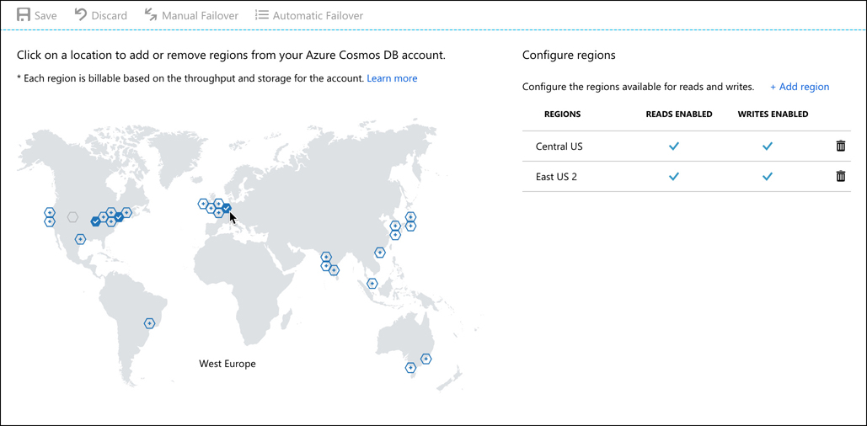
Azure Database products
Another huge advantage to Cosmos DB is a feature Microsoft calls turnkey global distribution. This feature takes advantage of the horizontal scalability of NoSQL databases and allows you to replicate your data globally with a few clicks. In the Azure portal, you can simply click on the region(s) where you want data replicated.
Once you click Save, Cosmos DB will begin to replicate data, which will be available in the selected regions. This makes it easy to ensure that users have the fastest experience possible with an application.
Azure Cosmo DB

Slide 52
Agenda
Azure compute
Azure networking
Azure storage products
Azure database products
The Azure Marketplace and its usage scenarios

Slide 53
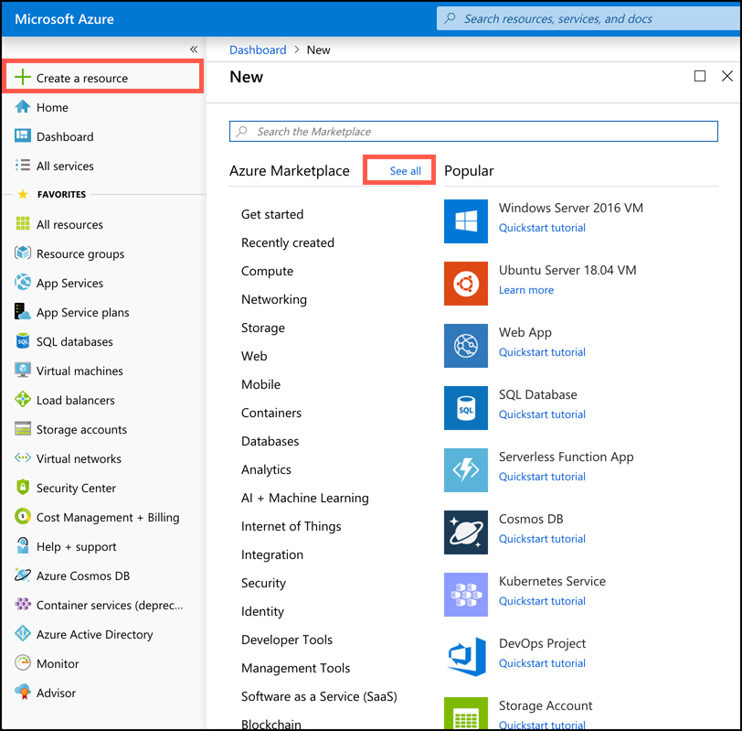
The Azure Marketplace and its usage scenarios
There are many available products outside of what we’ve discussed. Not only does Microsoft offer many additional services, but third-party vendors also provide a wide array of resources you can use in Azure. All of these resources are available in a single repository called the Azure Marketplace.
To access the Azure Marketplace, click on Create A Resource in the Azure portal. This will display a list of categories you can choose from. It will also show a list of popular offerings from all categories.
You can click on a category to see all templates in that category, and you can click a template in the list of popular templates, enter a search term, or even click See All to see all templates that are available.

Slide 54
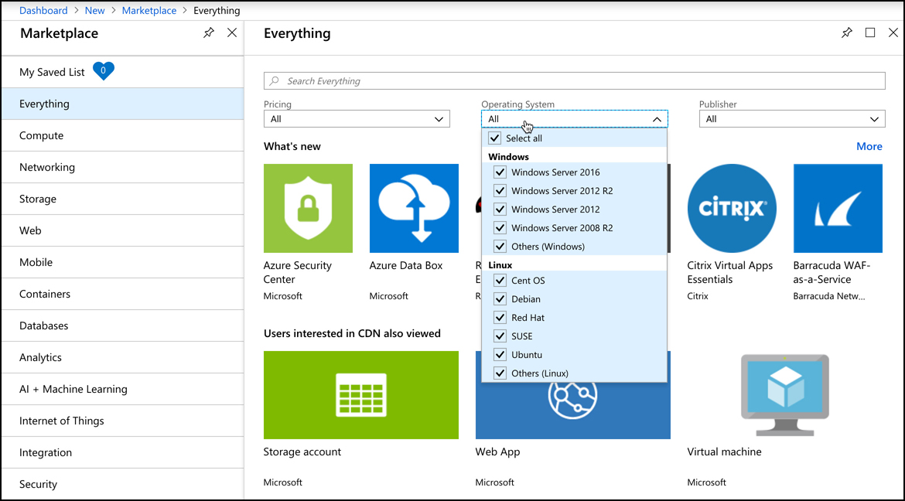
The Azure Marketplace and its usage scenarios
If you click See All, you’ll be taken to the full Marketplace experience where you can filter based on pricing, operating systems, and publisher.

Slide 55
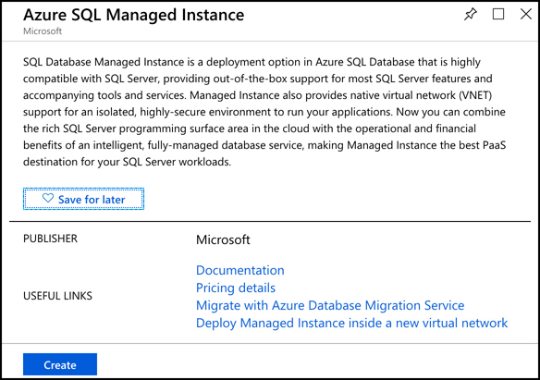
The Azure Marketplace and its usage scenarios
Many Marketplace templates provide links to documentation and other information to help you get the most out of the template. If you decide that you don’t want to immediately create the resources, you can click Save For Later and the template will be added to your saved list that you can access by clicking My Saved List as shown in the upper-left corner.

